Slide 1
Data Mart Analysis

Slide 2
Index
About Company
Problem
Process
Insights
Summary

Slide 3
About Company
Data Dart is my latest venture and I want your help to analyze the sales and performance of my venture. In June 2020 - large scale supply changes were made at Data Mart. All Data Mart products now use sustainable packaging methods in every single step from the farm all the way to the customer.

Slide 4
Problem
To Analyze The Data Given By Datamart And To Give Insights For Them To Take Data Driven Decisions and to quantify the impact of this change on the sales performance for Data Mart and its separate business areas.

Slide 5
Process
Problem Understanding
Data Understanding
Data Cleaning
Data
Analysis
Getting Insights

Slide 6
Insights
Total Transactions For Each Year

Slide 7
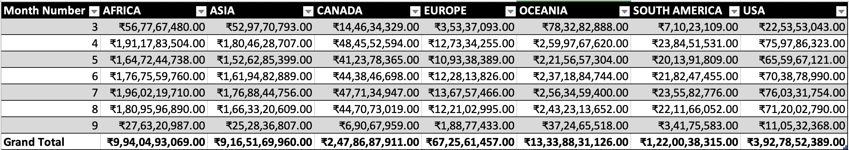
Insights
Total Sales For Each Region For Each Month

Slide 8
Insights
Total Count Of Transactions For Each Platform
Retail
Shopify
8586
8549

Slide 9
Insights
Percentage Of Sales By Demographic For Each Year In The Dataset

Slide 10
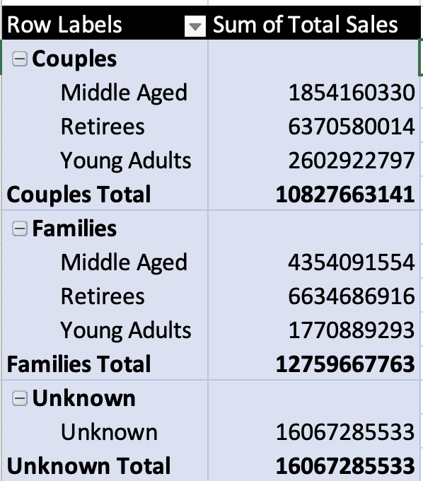
Insights
Age band And Demographic Values Contribute The Most To Retail Sales
By Looking At This Table We Can Conclude That Unknown Category Contributes The Most To The Retail Sales.

Slide 11
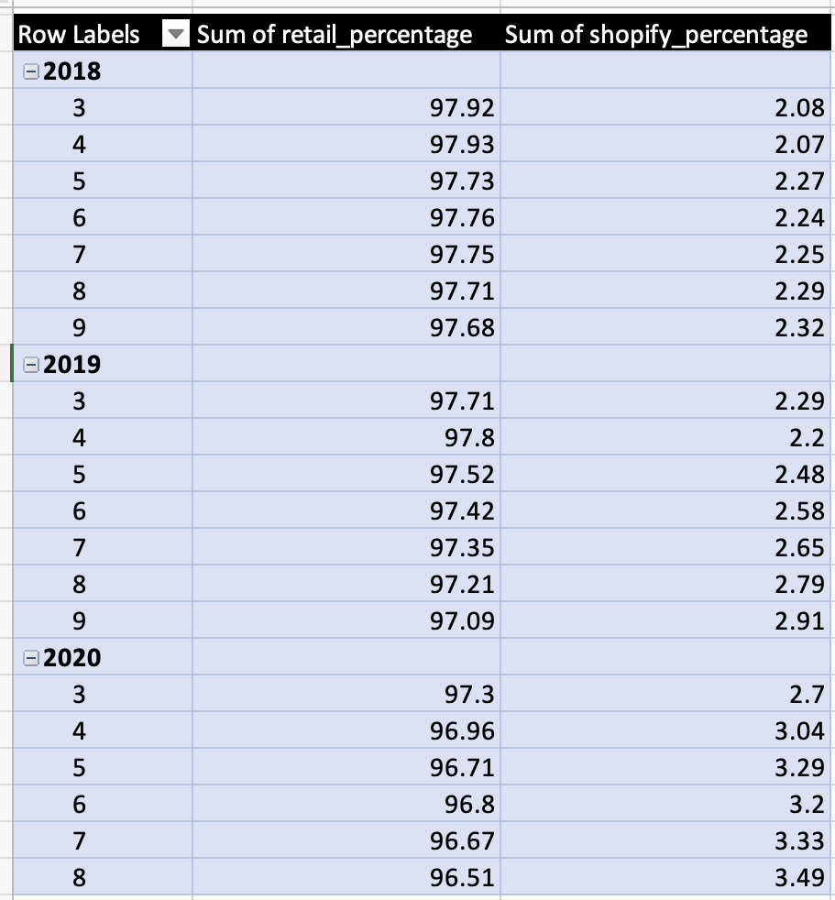
Insights
Percentage Of Sales For Retail Vs Shopify For Each Month

Slide 12
Summary
Europe Counts For Lowest Sales Among All Countries.
Sales Have Been Stable For All 3 Years.
Unknown Category Counts For Most Sales, So We Need To Identify Who The Unknowns Are.
By looking at percentage of sales for each platform for each month, we can say that after giving each product sustainable package, online shopify sales were increased.
Also, after giving each product sustainable packages sales in couples demographic increased.

